Slide 1

Solving the Rubik's Cube
Feature-Based Reinforcement Learning
A Team Project By:-
Rishi Krishna Thodupunuri (00787909)
Naga Pradeep Motupalli (00753204)
Susmitha Pathi (00759491)

Slide 2
Statement of Project Objective
Project Objective:
The main objective of the project is to solve the problem of a Rubik's cube, which is implemented through feature-based Q-Learning, a efficient reinforcement technique, as well as he utilization of a pattern database, to quantify the quality of near-finished cubes.
The 2x2x2 cube is much simpler to solve than the more common 3x3x3 cube. The state space is obviously smaller for 2x2x2 cube .
This project also attempts to find a solution for the cube which has n random moves executed on it.

Slide 3
Our Approach
A Short Glimpse Into Our Project.
Q-learning is a model-free reinforcement learning algorithm for determining the worth of a given action in a given state. It can handle problems with stochastic transitions and rewards without requiring adaptations and does not require a model of the environment (thus "model-free").
Tools and Techniques used are:
  Python and Feature based-Q-Learning

Slide 4
Deliverables
A Project Proposal
Project code
A video Demonstration (Youtube Upload)
Review (in a report)
Future Possibilities (In the report)

Slide 5
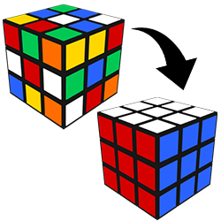
Evaluation:
The outcome should be checked to judge for the ability of the project to Solve simple Rubik’s cube that consists of 2x2x2 or 3x3x3 cubes.

Slide 6

Thank You

